Slide 1
THIRD GENERATION ATM MACHINE COMPUTER VISION TECHNIQUES
PRESENTED BY :
GOKULA KRISHNAN.V (820319104017)
SATHISH.S
(820319104037)
VISHWA VENGADESH.D
(820319104048)
TAMIL SELVAN.S
(820319104303)
GUIDED BY :
ARUNPANDIYAN.A
ASSISTANT PROFESSOR / CSE

Slide 2
Objective
This project is aimed to reduce the risk involved in ATM machines that were installed in remote area, also the issue related to fraudulent transaction like misusing others card to withdraw money and etc.
So in order to overcome these challenges, we have developed solution that will leverage the ML & AI to restrict card access to only the authorized users those are identified by face recognition algorithm.

Slide 3
ABSTRACT
Automated teller machines (ATMs) are well known devices typically used by individuals to carry out a variety of personal and business financial transactions and/or banking functions.
ATMs have become very popular with the general public for their availability and general user friendliness. ATMs are now found in many locations having a regular or high volume of consumer traffic.
For example, ATMs are typically found in restaurants, supermarkets, Convenience stores, malls, schools, gas stations, hotels, work locations, banking centers, airports, entertainment establishments, transportation facilities and a myriad of other locations.
ATMs are typically available to consumers on a continuous basis such that consumers have the ability to carry out their ATM financial transactions and/or banking functions at any time of the day and on any day of the week.for this purpose we are using face recognition step with haar cascade classifier to find out the features of face.when face is detected then it will give access to do transactions otherwise not allow.

Slide 4
SCOPE OF THE PROJECT
Capture human faces from webcam.
Create data set to train AI
Analyse face data with bank server to identify person
If both data matches, then person will be allowed to proceed transaction
If data mismatch, then email will be triggered to the person’s email that is configured in bank system. And transaction will be denied.

Slide 5
LITERATURE SURVEY
Author | Title | Critique | Year
Li et al | Learning Deep Models for Face Anti-spoofing: Binary or Auxiliary Supervision | The paper proposes a method that combines binary supervision and auxiliary supervision to improve the performance of face anti-spoofing. The approach outperforms existing methods on several benchmark datasets. | 2022
Zhang et al | A Two-Stream Convolutional Neural Network for Face Anti-Spoofing | The paper proposes a two-stream CNN architecture that combines texture and depth information to detect fake faces. The method achieves state-of-the-art performance on several benchmark datasets. | 2022
Zhou et al | LivenessNet: A Lightweight Network for Face Anti-Spoofing | The paper proposes a lightweight CNN architecture that is efficient for real-time face anti-spoofing. The method achieves competitive results with state-of-the-art methods while requiring fewer computations. | 2022

Slide 6
EXISTING SYSTEM
In existing system RFID card is used as ATM card, IR sensor in order to sense the presence of the card holders and to turn on Fan and Light, if ATM is tampered then SMS is sent to two main stations via GSM.
Based on WI fall detection get security, that network access is not that much secured.
The biometrics like fingerprint and eyeball authentication are prone for easy spoofing.

Slide 7
DRAWBACK
Card less transaction is not possible.
RFID based ATM access are prone to security issues.

Slide 8
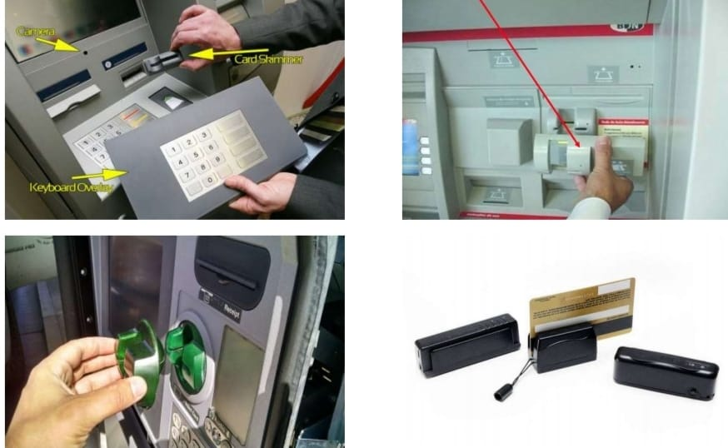
PROBLEM IDENTIFICATION
Card Skimming :
The scammers try to steal your card details so they can access your accounts. Once
scammers have skimmed your card, they can create a fake or clone card with your
details on it. The scammer is then able to run up charges on your account.

Slide 9
PROPOSED SYSTEM
1.Facial recognition:
Facial recognition can be used to identify the customer, allowing them to access their account without the need for a physical ATM card. This could improve security by reducing the chances of fraud and theft.
2.Gesture recognition:
Gesture recognition can allow customers to interact with the ATM machine using hand gestures, eliminating the need for physical buttons. This could improve hygiene and reduce the spread of germs, especially during a pandemic.

Slide 10
PROPOSED SYSTEM
3.Object recognition:
Object recognition can be used to detect skimming devices or other unauthorized modifications to the ATM machine, alerting security personnel and preventing fraudulent activity.
4. Image-based deposit verification:
Customers can use the ATM machine to deposit checks or cash, and computer vision techniques can be used to verify the authenticity of the deposit.

Slide 11
PROPOSED SYSTEM
5.Queue management:
Computer vision techniques can be used to monitor the number of customers waiting in line and estimate the time it will take to serve them. This information can be used to optimize the operation of the ATM machine and improve the customer experience.
6.Real-time security monitoring:
Computer vision techniques can be used to monitor the ATM machine and surrounding area in real-time, alerting security personnel to any suspicious activity.

Slide 12
REQUIREMENTS
HARDWARE REQUIREMENT
SOFTWARE REQUIREMENT
Processor : Processor Intel CORE i3
RAM : 4 GB
Internet Connection : 20 mbps
Operating System : Windows, Mac, Linux
Language : Python 3.7 (opencv)

Slide 13
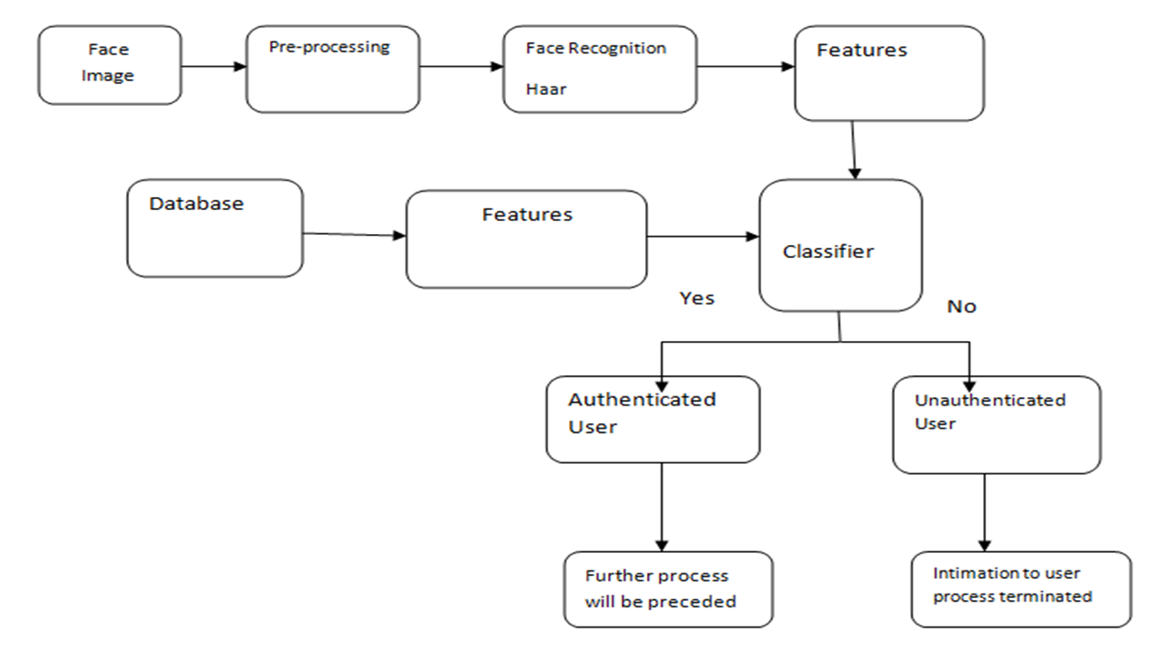
BLOCK DIAGRAM

Slide 14
PRE-PROCESSING
Image Pre-processing is a common name for operations with images at the lowest level of abstraction. Its input and output are intensity images. The aim of pre-processing is an improvement of the image data that suppresses unwanted distortions or enhances some image features important for further processing.
Image restoration is the operation of taking a corrupted/noisy image and estimating the clean original image. Corruption may come in many forms such as motion blur, noise, and camera misfocus. Image restoration is different from image enhancement in that the latter is designed to emphasize features of the image that make the image more pleasing to the observer, but not necessarily to produce realistic data from a scientific point of view.

Slide 15
MODULE EXPLANATION
1.Face Recognition:
Face recognition technology is used to identify the user before allowing access to the ATM machine. The user's face is captured using a camera and matched against a database of known faces to verify their identity.
2.Object Detection:
Object detection techniques are used to identify any suspicious objects or movements near the ATM machine. This can help prevent theft or vandalism.

Slide 16
MODULE EXPLANATION
3.Optical Character Recognition (OCR):
OCR techniques are used to read and interpret text on the user's ID or card, enabling faster and more accurate identification.
4.Motion Detection:
Motion detection algorithms are used to detect any unusual movements near the ATM machine, such as someone trying to tamper with the machine or insert a skimming device.

Slide 17
MODULE EXPLANATION
5.Fraud Detection:
Machine learning algorithms are used to analyze user behavior and identify any suspicious activity, such as multiple failed login attempts or unusually large withdrawals.
6.User Interface:
Advanced computer vision techniques are also used to improve the user interface of the ATM machine, including touch-free interfaces that use hand gestures or voice commands to complete transactions.

Slide 18
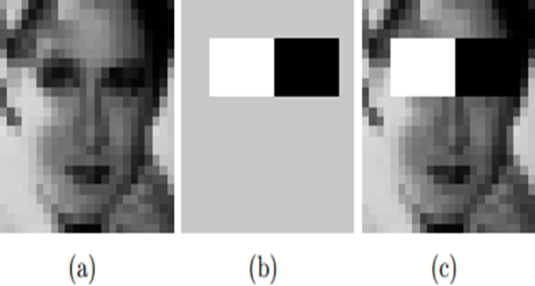
HAAR CASCADE CLASSIFIER
Haar- like features are rectangular patterns in data. A cascade is a series of “Haar-like features” that are combined to form a classifier [14]. A Haar wavelet is a mathematical function that produces square wave output.

Slide 19
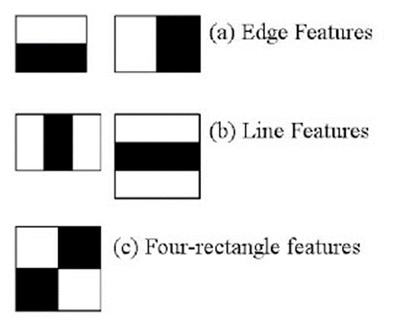
HAAR CASCADE FEATURES
Object Detection using Haar feature-based cascade classifiers is an effective object detection method proposed by Paul Viola and Michael Jones in their paper, “Rapid Object Detection using a Boosted Cascade of Simple Features”.
It is a machine learning based approach where a cascade function is trained from a lot of positive and negative images. It is then used to detect objects in other images.

Slide 20
CONCLUSION
This project is aimed to reduce the risk involved in ATM machines that were installed in remote area, also the issue related to fraudulent transaction like misusing others card to withdraw money and etc.
So in order to overcome these challenges, we have developed solution that will leverage the ML & AI to restrict card access to only the authorized users those are identified by face recognition algorithm.

Slide 21
REFERENCE
•I. Banerjee, S. Mookherjee, S. Saha, S. Ganguli, S. Kundu and D. Chakravarti, "Advanced ATM System Using Iris Scanner," 2019 International Conference on Opto-Electronics and Applied Optics (Optronix), Kolkata, India, 2019, pp. 1-3.
doi: 10.1109/OPTRONIX.2019.8862388
•S. Sankhwar and D. Pandey, "A Safeguard against ATM Fraud," 2016 IEEE 6th International Conference on Advanced Computing (IACC), Bhimavaram, India, 2016, pp. 701-705.
doi: 10.1109/IACC.2016.135
•Y. Cheng, W. Shang, L. Zhu and D. Zhang, "Design and implementation of ATM alarm data analysis system," 2016 IEEE/ACIS 15th International Conference on Computer and Information Science (ICIS), Okayama, Japan, 2016, pp. 1-3.
doi: 10.1109/ICIS.2016.7550948
•C. Porretti, R. Lahaije and D. Kolev, "A New Vision for ATM Security Management: The Security Management Platform," 2016 11th International Conference on Availability, Reliability and Security (ARES), Salzburg, Austria, 2016, pp. 493-498.
doi: 10.1109/ARES.2016.50
• H. R. Babaei, O. Molalapata and A. A. Pandor, Face Recognition Application for Automatic Teller Machines (ATM), in ICIKM, 3rd ed. vol.45, pp.211-216, 2012.
•Aru, O. Eze and I. Gozie, Facial Verification Technology for Use in ATM Transactions, in American Journal of Engineering Research (AJER), [Online] 2013, pp. 188-193, Available:http://www.ajer.org/papers/v2 (5)/Y02501880193.pdf ← K.

